Slide 1


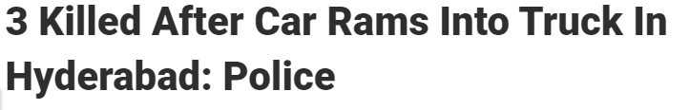

Code Armageddon STMat (Smart Traffic Management)

Slide 2
TRACK CHOSEN: URBANIZATION AND CITY PLANNING

Slide 3
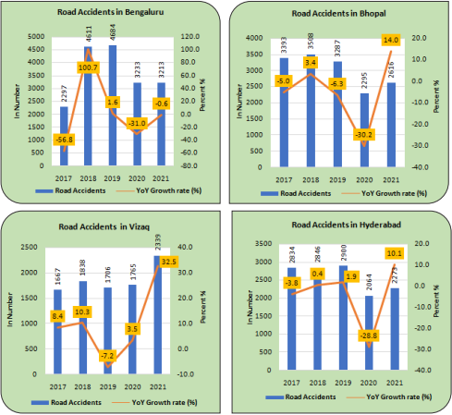
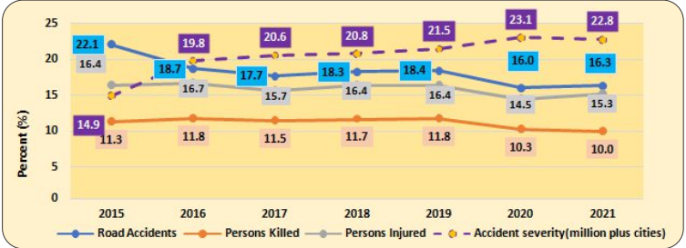
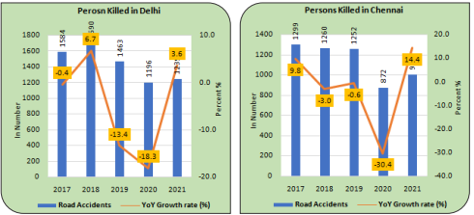

Slide 4
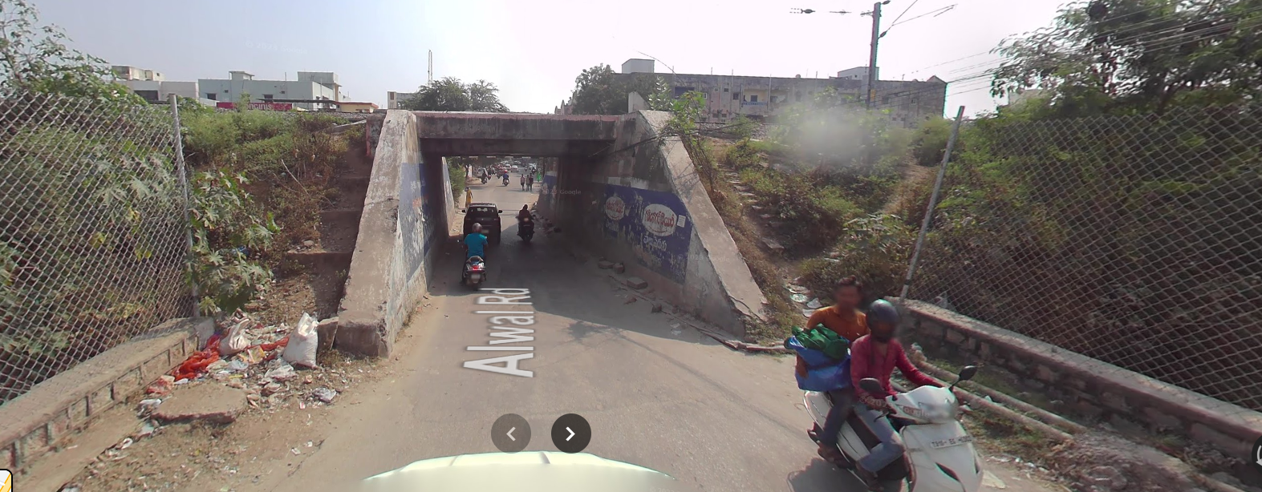
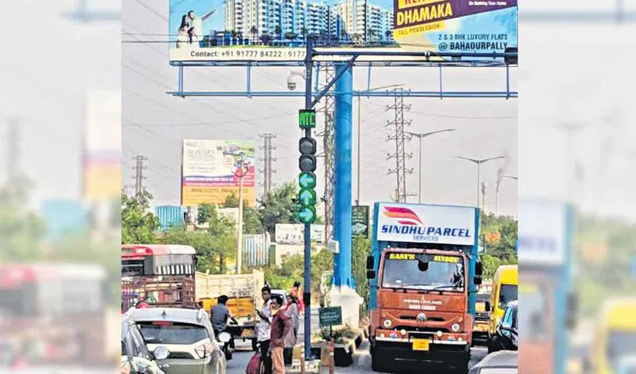
Purpose of our project
Our project aims on eliminating the traffic congestions faced in two way junctions in places such as narrow underpasses and one way roads.
The complicated ATSC cannot be implemented in such places and hence necessitates the usage of simpler systems.

Slide 5

Components of our project
Our project uses simple python logic in order to simplify the process of traffic management.
It can use pre-exisiting cameras that are around the junction in order to manage the signal timings.
All it needs is the live footage from the cameras either side

Slide 6
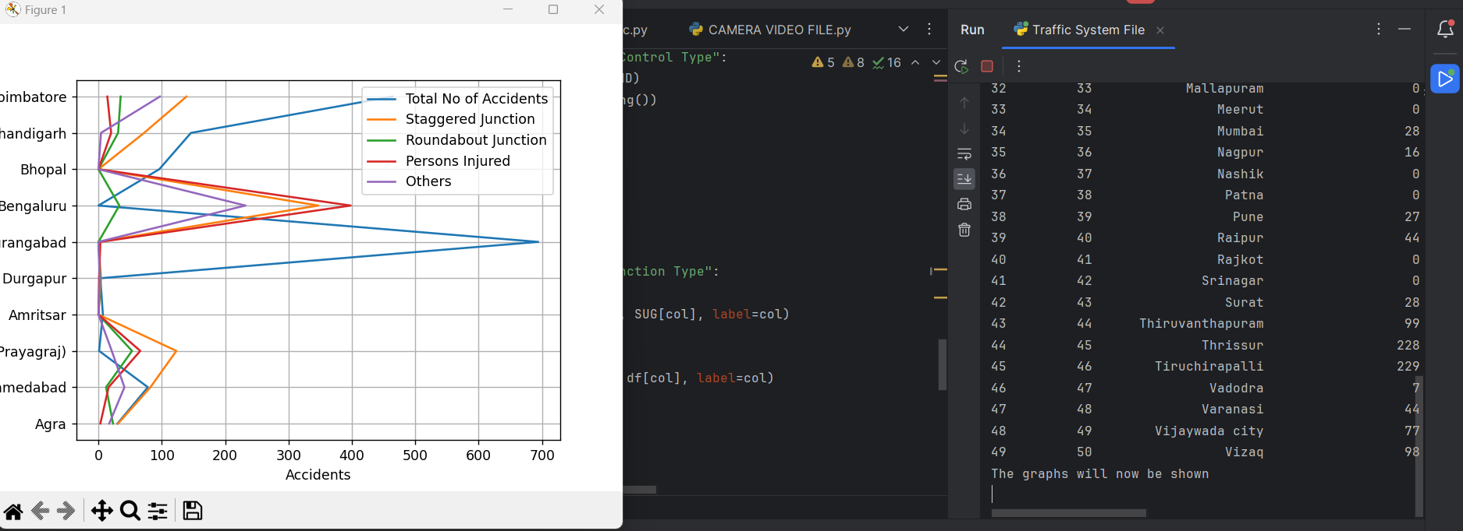
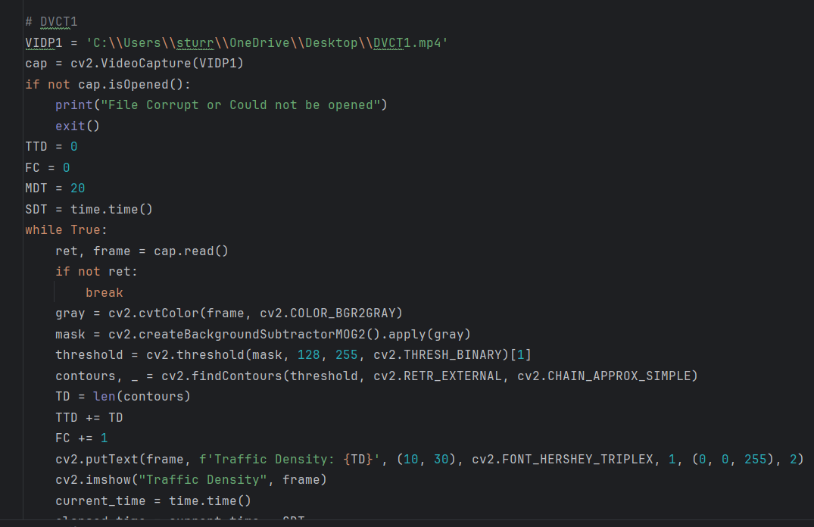
Working of our project
Our project is split into 3 components:
The statistic display
The traffic density identifier(can be any camera)
The code logic for the traffic density
The GUI for the signal

Slide 7
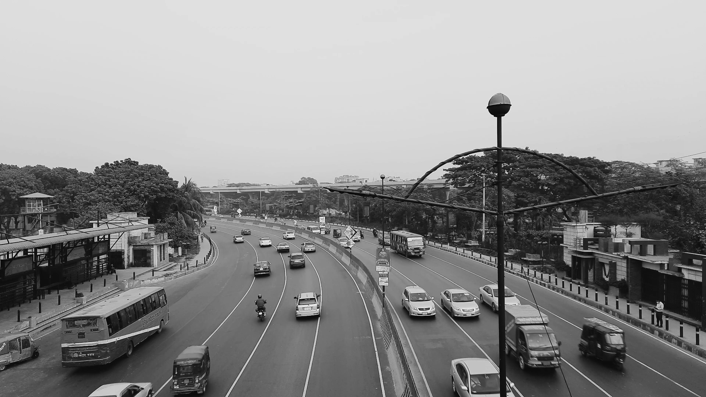
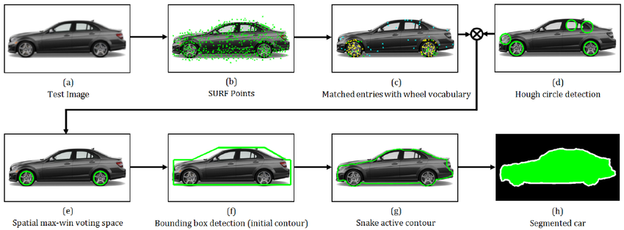
Explanation of code logic
The code works by using the module of open cv that has been imported into the coding in python.
Working of the code:
The footage is first converted into grayscale for further identification of the number of vehicles.
CV2 filters such as background subtractor have been used in order to further enhance the footage for identification.
Once the filters have been used, the contour identification process takes place.
All the contours are identified and then the total number of cars at a particular moment are recognised.
Finally, from all this data the traffic density for a duration of 30s to 1m is calculated in order to vary the signal timing.

Slide 8
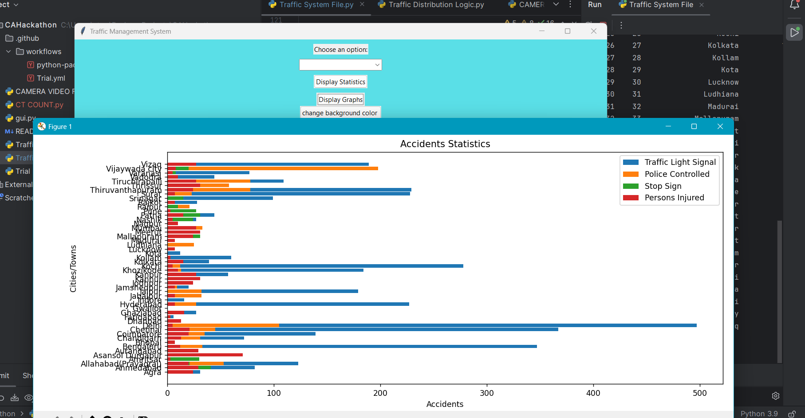
Explanation of the GUI logic
The tkinter module has been used in order to convert the entire code into a GUI.
Definitions have been used in order to display the code part by part in order.
The final result is a proper GUI which uses stock footage in order to calculate the signal timings and shows the output in the form of a traffic signal along with timings.

Slide 9
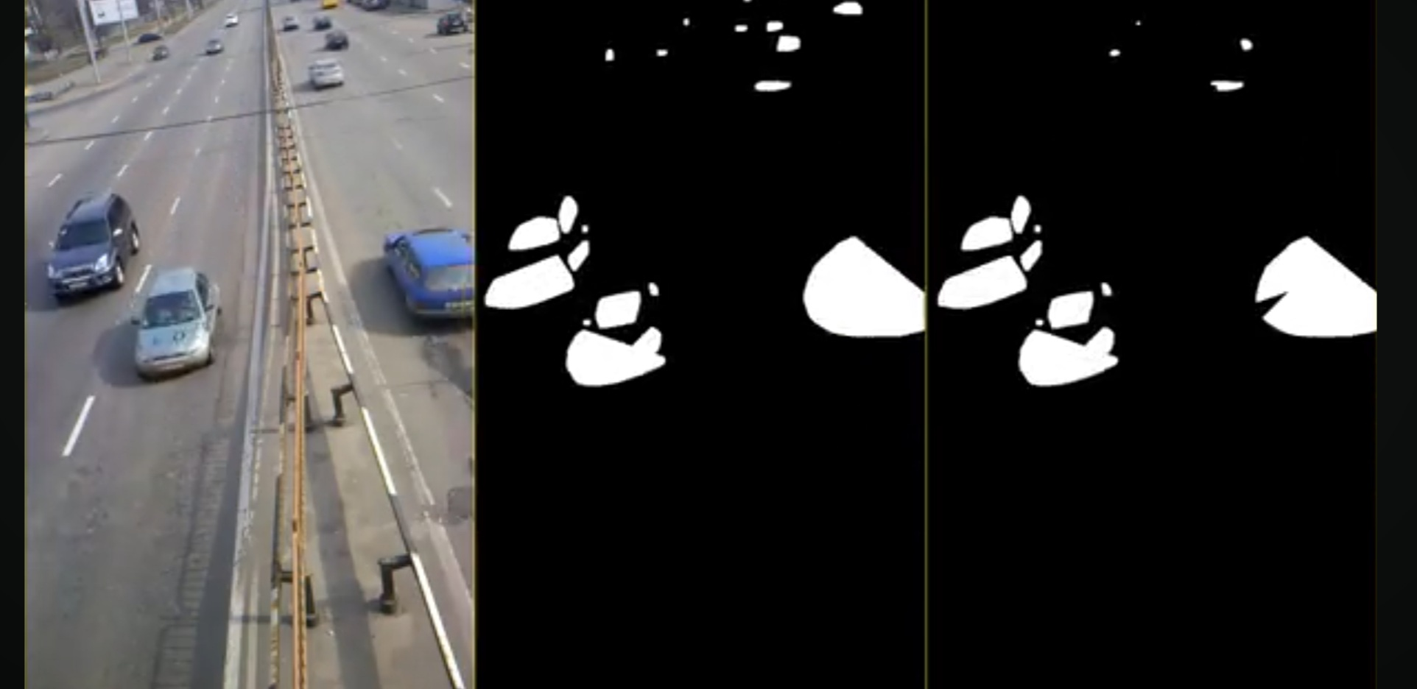
Demonstration of the code
The code will now be demonstrated, please sit back relax and enjoy the stock traffic footage.

Slide 10
QUESTIONS

